Slide 1
Asymptotic Notation
CS 3100 – Data Structures & Algorithms
Lecture materials adapted from:
Coursenotes
A Practical Introduction to
Data Structures and Algorithm Analysis
Second Edition
Clifford A. Shaffer
Department of Computer Science
Virginia Tech
Copyright © 2000, 2001

Slide 2
Growth Classes
n | 0 | 5 | 10 | 25 | 50 | 100 | 1,000
n² | 0 | 25 | 100 | 625 | 2,500 | 10,000 | 1,000,000
n²+2n+5 | 5 | 40 | 125 | 680 | 2,605 | 10,205 | 1,002,005
n²/(n²+2n+5) | 0 | 0.625 | 0.800 | 0.919 | 0.960 | 0.980 | 0.998
Now, let’s formalize our definition of “approximately equal to”
Lecture 03: Asymptotic Notation

Slide 3
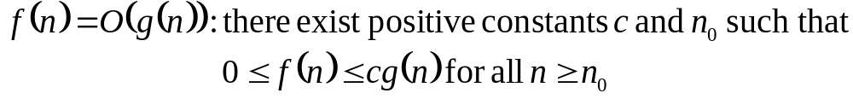
Big-O
What does it mean?
  If f(n) = O(n²), then:
    f(n) can be larger than n² sometimes, but…
    I can choose some constant c and some value n₀ such that for every value of n larger than n₀ : f(n) < cn²
    That is, for values larger than n₀, f(n) is never more than a constant multiplier greater than n²
    Or, in other words, f(n) does not grow more than a constant factor faster than n².
Lecture 03: Asymptotic Notation

Slide 4
Visualization of O(g(n))
cg(n)
f(n)
n₀
Lecture 03: Asymptotic Notation

Slide 5
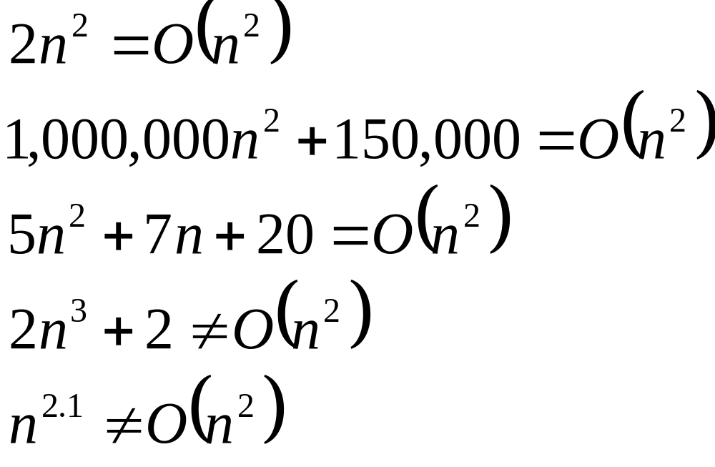
Big-O
Lecture 03: Asymptotic Notation

Slide 6
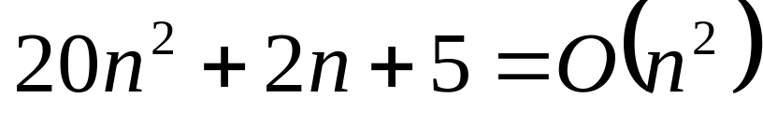
More Big-O
Prove that:
Let c = 21 and n₀ = 4
21n² > 20n² + 2n + 5 for all n > 4
n² > 2n + 5 for all n > 4
TRUE
Lecture 03: Asymptotic Notation

Slide 7
Tight bounds
We generally want the tightest bound we can find.
While it is true that n² + 7n is in O(n³), it is more interesting to say that it is in O(n²)
Lecture 03: Asymptotic Notation

Slide 8

Big Omega – Notation
Ω() – A lower bound
  n² = Ω(n)
  Let c = 1, n₀ = 2
  For all n ≥ 2, n² > 1 × n
Lecture 03: Asymptotic Notation

Slide 9
Visualization of Ω(g(n))
f(n)
cg(n)
n₀
Lecture 03: Asymptotic Notation

Slide 10
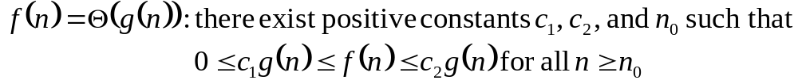
Θ-notation
Big-O is not a tight upper bound. In other words n = O(n²)
Θ provides a tight bound
In other words,
Lecture 03: Asymptotic Notation

Slide 11
Visualization of Θ(g(n))
c₂g(n)
f(n)
c₁g(n)
n₀
Lecture 03: Asymptotic Notation

Slide 12
A Few More Examples
n = O(n²) ≠ Θ(n²)
200n² = O(n²) = Θ(n²)
n^{2.5} ≠ O(n²) ≠ Θ(n²)
Lecture 03: Asymptotic Notation

Slide 13
Some Other Asymptotic Functions
Little o – A non-tight asymptotic upper bound
  n = o(n²), n = O(n²)
  3n² ≠ o(n²), 3n² = O(n²)
Ω() – A lower bound
  Similar definition to Big-O
  n² = Ω(n)
ω() – A non-tight asymptotic lower bound
f(n) = Θ(n) ⇔ f(n) = O(n) and f(n) = Ω(n)
Lecture 03: Asymptotic Notation

Slide 14
Visualization of Asymptotic Growth
ω(f(n))
Ω(f(n))
Θ(f(n))
f(n)
O(f(n))
o(f(n))
n₀
Algorithm Analysis

Slide 15
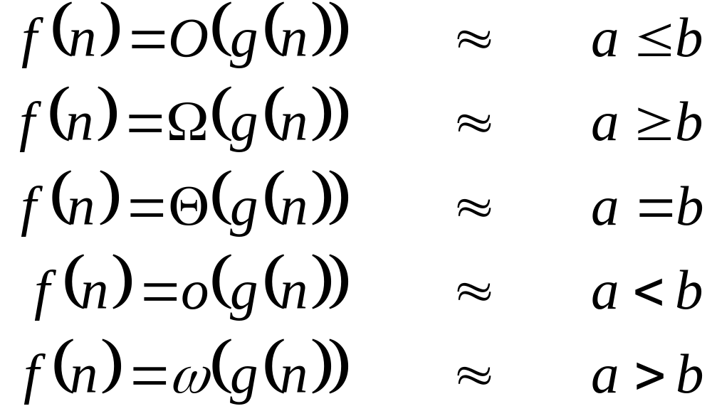
Analogy to Arithmetic Operators
Lecture 03: Asymptotic Notation

Slide 16
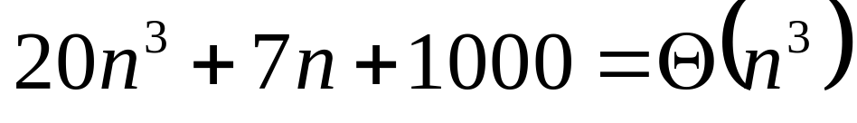
Example 2
Prove that:
Let c = 21 and n₀ = 10
21n³ > 20n³ + 7n + 1000 for all n > 10
n³ > 7n + 5 for all n > 10
TRUE, but we also need…
Let c = 20 and n₀ = 1
20n³ < 20n³ + 7n + 1000 for all n ≥ 1
TRUE
Lecture 03: Asymptotic Notation

Slide 17
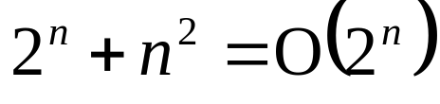
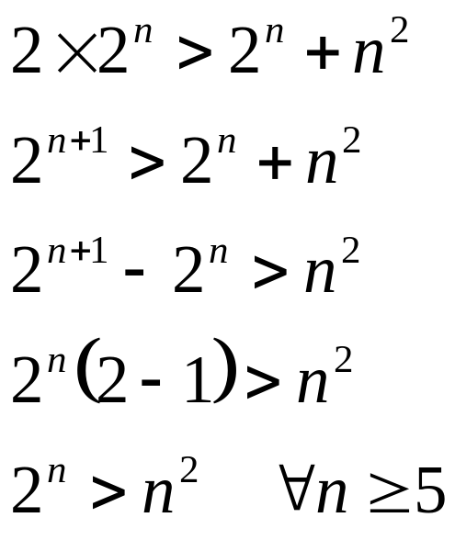
Example 3
Show that
Let c = 2 and n₀ = 5
✓
Lecture 03: Asymptotic Notation

Slide 18
A Big-O Hierarchy
O | Asymptotic Upper Bound
O(1) | Constant
O(log_{a}(n)) | Logarithmic
O(n) | Linear
O(n log_{a}(n)) | n log n
O(n²) | Quadratic
O(n³) | Cubic
O(n^{r}) | Polynomial (r ≥ 0)
O(b^{n}) | Exponential (b > 1)
O(n!) | Factorial (and exponential)
Lecture 03: Asymptotic Notation

